Slide 1




BEHAVIOUR CURRICULUM St Augustine’s Catholic Voluntary Academy Stamford
March 2025

Slide 2

What is a Behaviour Curriculum?
Defines what expected behaviour looks like in your school, rather than just list prohibited behaviours. It’s a way to teach pupils ‘how we do things around here’.
Centre around the teaching of routines and habits - these should be used to reinforce the behaviours expected of all pupils.
Reflect our school mission statement, values and virtues.
Be aware of diversity and SEND needs and possible need for reasonable adjustments.

Slide 3

Why is it called ‘Flourish in love’?
Our school mission statement is ‘Let all that you do be done in love.’ (1 Corinthians 16:14)
We have 12 school virtues, organised into 6 pairs.
If children practise these virtues so much that they become habits, they truly flourish and fulfil their personal potential as good citizens.
Therefore, by following and practising our virtues, every day, we ‘flourish in love’.

Slide 4





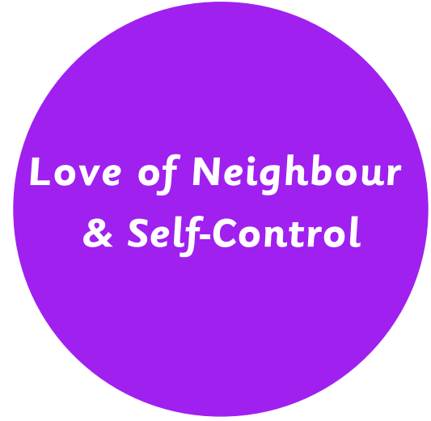
What are our TWELVE school VIRTUES and our school MISSION STATEMENT?
Advent 1 Setting personal and learning goals for the year ahead | Advent 2 A time of HOPE as we await the birth of Jesus at Christmastime | Lent 1 Repentance (saying sorry) during Lent | Lent 2 The ultimate act of love from Jesus at Easter, dying on the cross for our sins | Pentecost 1 Discipleship and spreading the Good News | Pentecost 2 Transition, Faith in Action and living out our mission in the community

Slide 5
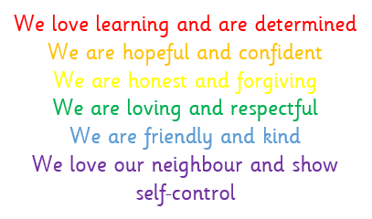
Let’s begin with Our School Rules
Our school rules are written to reflect our 12 school virtues.
Following our school rules helps everyone to FLOURISH.
We follow our Mission Statement and ‘do everything in love’.

Slide 6
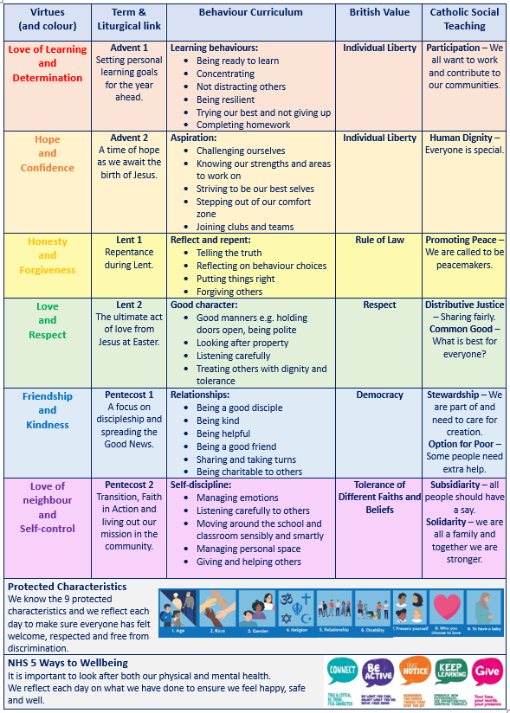
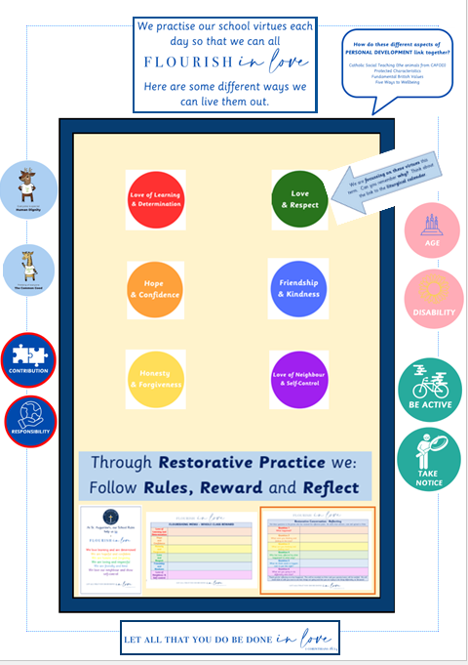
How do we TEACH behaviour?
Each half term, we focus in on two virtues
We start every half term with a ‘Virtues Day’ in each classroom
An activity helps the children to understand what one, or both, of the virtues means and how it applies to them
We explore with the children, in an age-appropriate way, how we can practise and show the virtue through our behaviour, in different places and situations around school and throughout the school day e.g. in lessons, assembly, the dining hall, corridor and playground
We annotate our classroom ‘FLOURISH’ board with our thoughts
We make links with the other aspects of ‘Personal Development’:
British Values
Protected Characteristics
Catholic Social Teaching
NHS Five Ways to Wellbeing

Slide 7

How do we REWARD behaviour?
Virtue points are awarded for those children practising the virtues.
Virtue points are added to the child’s avatar on Class Dojo, in line with which virtue pair has been shown.
There are various benefits to these points, beyond the point itself.

Slide 8
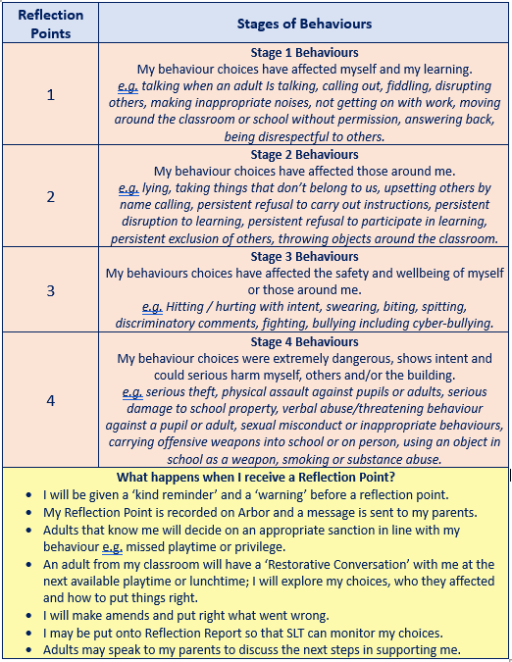
How do we SANCTION behaviour?
The policy is rooted in positive relationships and aims not to be shaming e.g. no visual ‘moving down’ system.
Sanctions are staged with clear examples of behaviours.
Reflection points are recorded on Arbor and parents notified via standard email for stages 2 to 4.
Restorative conversations are very important for both the child who has made a mistake (reflecting), and any children who may have been hurt or upset by that (repairing) – see next slide.
‘Appropriate sanctions’ are decided upon by an adult that knows me well e.g. if I’ve broken something, I try to put it back together or fix it once I’m calm enough.
If needed, a child may move to ‘Reflection Report’ for a period of intense support from SLT.
Parents will be kept informed and involved in any ‘Pastoral Support Planning’ or SEND plans, if/when it is felt this is needed.

Slide 9
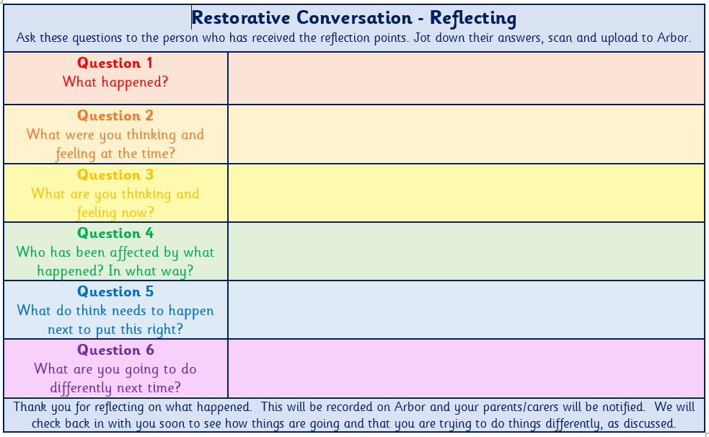
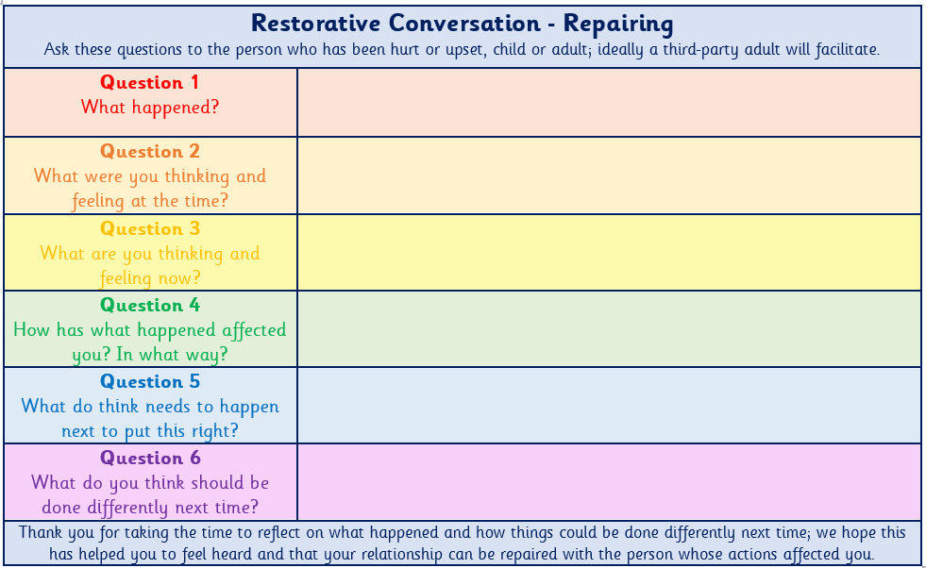
Restorative Conversations
Restorative practice is a behaviour model that encourages children to take responsibility for their actions by thinking through the causes and consequences.
Rather than an adult telling a child what they did wrong and removing playtime, it involves helping the child think through their behaviour, its effects and what they can now do to ‘put it right’. It also involves reparation for any person who was hurt.
It’s all about developing, maintaining and repairing relationships, building a community based around empathy and self-learning, where children take responsibility for their actions.
In primary school this centres around a set of key questions that help children think about their behaviour and understand how they can repair it.
This can look different depending on the age of the child e.g. younger children might use puppets
The key thing is not to shout, blame, shame or publicly humiliate the children, instead focusing on understanding the behaviour as communication and teaching behaviour modification over time.

Slide 10
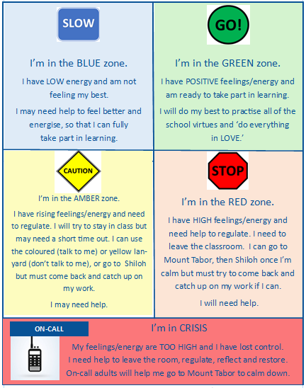
Wellbeing Procedure & Zones of Regulation
Sitting alongside the behaviour policy is our ‘wellbeing procedure’ which is rooted in ‘zones of regulation’.
All behaviour is a communication, often linked with our emotions.
We teach children to better understand, talk about and learn to manage their feelings through the ‘zones of regulation’ colours.
Each classroom has a ‘Flourish’ board which encourages children to reflect on their feelings throughout each day.
We start and end each day reflecting on our feelings and the journey we’ve been on throughout the day.
This procedure helps children understand how to regulate, where to go and that they may need help.

Slide 11

Evidence of outcomes of our Behaviour Curriculum
St Augustine's Catholic Voluntary Academy is a warm and welcoming school. Pupils are happy here. They feel safe and well-cared for by dedicated staff. The school provides well for pupils’ wider personal development. The twelve school virtues inspire pupils to develop good learning behaviours and prepare them to be good citizens of the future.
There are many opportunities for pupils to develop their character. This includes leadership responsibilities with the school council or acting as playground leaders, for example. Through daily assemblies, pupils learn to respect equality and understand different faiths and cultures.
Ofsted, 2025

Slide 12

Evidence of outcomes of our Behaviour Curriculum
Pupils are polite and courteous. They behave well in lessons and around school. When pupils do not behave as well as they should, staff calmly help them to reflect on, and correct, their behaviour. Pupils who struggle to regulate their behaviour, or manage their emotions, receive excellent support.
Ofsted, 2025

Slide 13

Evidence of outcomes of our Behaviour Curriculum
Pupils at St Augustine’s understand that they are members of a Catholic community, confidently saying, ‘we care for one another, and this makes us better people’. Pupils show respect for one another. They talk about how they welcome new pupils and visitors from all faith backgrounds, and none, to their school. Pupils know their mission in following Jesus and how they care for God’s creation through their ‘Laudato Si’ work, linked to Catholic Social Teaching. Pupils clearly understand their school’s Catholic virtues and connect these to other areas of school life saying, ‘We come together as a community in the name of God’.
Catholic Schools Inspection, 2024

