Slide 1
Let’s prepare for the day by working on our PERSONAL DEVELOPMENT How will you be the best version of yourself today?

Slide 2
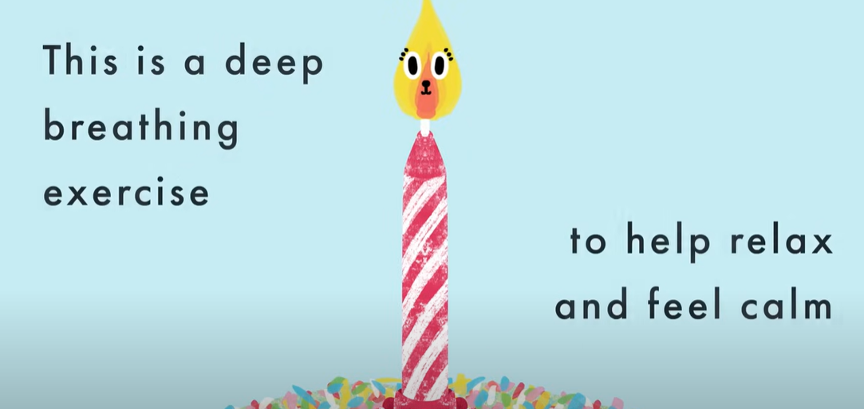
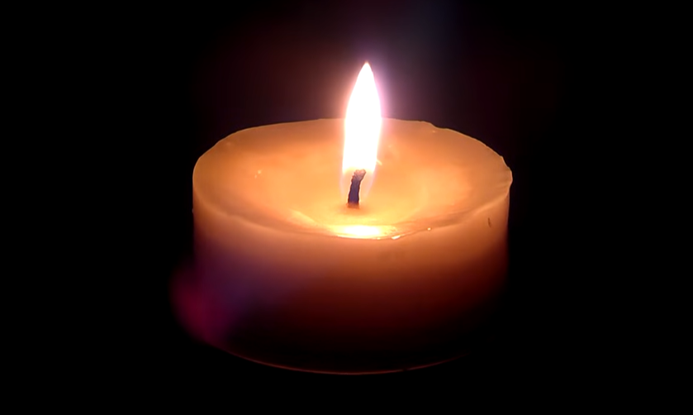
Mindful Minute (Daily)
MINDFUL MINUTE
How has morning been so far? Let’s calm our bodies and focus our minds.
Click
Here
→
What would you like to say to God today? Will you say thank you, say sorry or
ask for God’s help with something? You can share your thoughts with the class or
have a quiet moment with your prayers. In Jesus’ name, Amen.

Slide 3
Good Morning – Let’s today!
MISSION MONDAY
Practising our virtues every day allows us to FLOURISH
and be the very best person we can be, living out our
mission statement.
Have a look at our old school crest…
Which of our virtues will you follow today?
What will you try to do?
How do you think it will make you and others feel?
Will it be easy or will you have to try hard?
Lord, may we learn to live a life of love, through the Spirit who dwells in us, Amen.

Slide 4
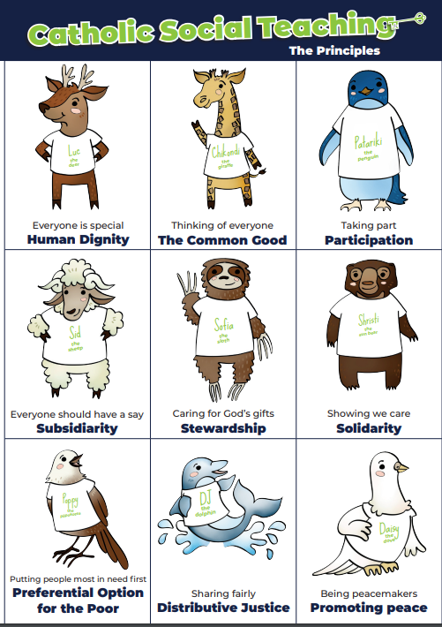
Good Morning – Let’s today!
CST TUESDAY (Catholic Social Teaching Principles)
Think of ways you can act in love today?
Human Dignity – Everyone is special
Subsidiarity – Everyone should have a say
The Common Good – Thinking of everyone
Participation – Taking Part
Stewardship – Caring for God’s gifts
Distributive Justice – Sharing fairly
Solidarity – Showing we care
Promoting Peace – Being peacemakers
Preferential Option for the Poor – Putting people in
need first
Let’s offer up our loving actions today, to our loving
Father in Heaven, Amen.

Slide 5
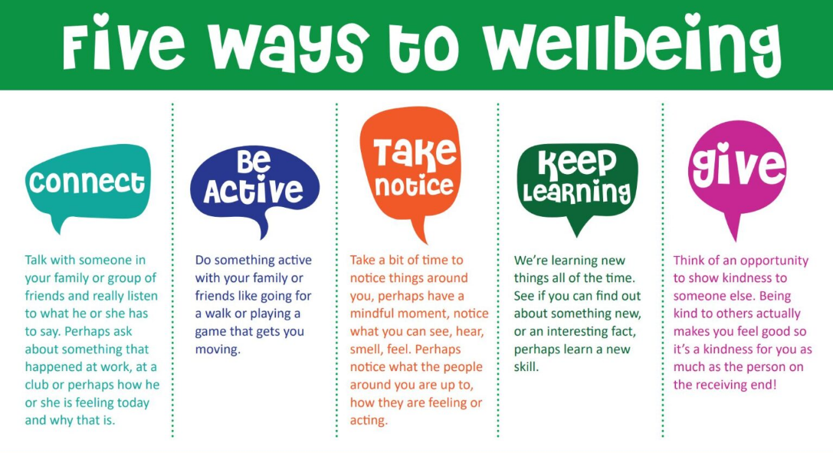
Good Morning – Let’s today!
WELLBEING WEDNESDAY
How are you feeling today?
In what ways have you taken care
of your mental health so far this week?
Talk to a friend about which of the
NHS 5 Ways to Wellbeing you have
followed and how.
As we follow our mission statement, remember that it’s important to love
ourselves as well as others, just as God loves us, unique and wonderfully made
in His image. We ask our mother, Mary, to pray for our health and happiness, Amen.

Slide 6
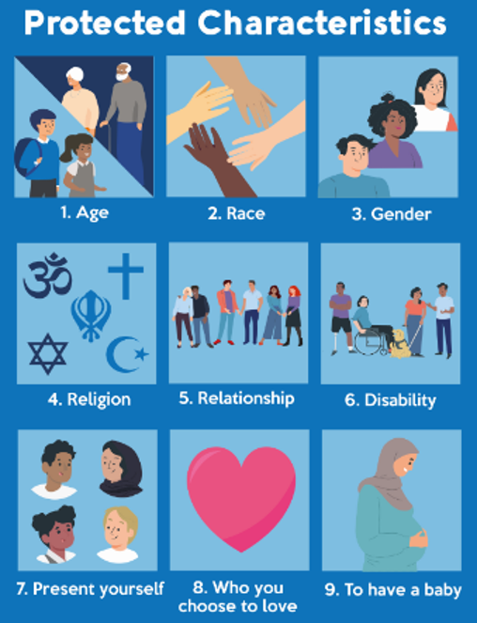
Good Morning – Let’s today!
THOUGHTFUL THURSDAY
Have you shown love, respect and tolerance already this week?
Have you had to think carefully about your actions?
Have you had to stop yourself, or anyone else from
discriminating against someone based on their
PROTECTED CHARACTERISTICS?
As we follow our mission statement, remember that it’s important to love one another as Jesus loves us, practising our virtues of RESPECT and LOVE OF NEIGHBOUR.
We ask Jesus to strengthen us in our mission to always to what is right,
fair and just, Amen.

Slide 7
Good Morning – Let’s today!
FREE-DAY FRIDAY (BRITISH VALUES)
Following the British Values ensures you become valuable and fully rounded members of society who treats others with respect and tolerance, regardless of their background.
They prepare you for life in modern Britain.
Q. How will you show good citizenship today?
Q. Which of the British Values will you try to follow?
Q. How might others showing these values help you?
Not all people in the world are free to make their own
choices or treated fairly. Let’s offer up our thanks to God
for all the things in our lives that keep us safe from harm
and pray for those less fortunate than ourselves today.
Lord, help us to care for others as you care for us. Amen

